Slide 1


Hextron
Inspired by Hextris.io
By Scott Williams, Jason Li, Yousaf Shaheen

Slide 2
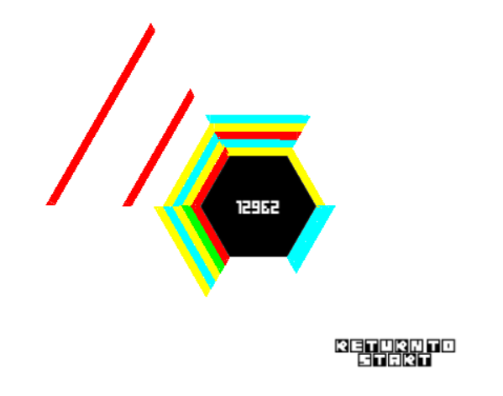
Hextron
Purpose and Scope
Based off Hextris.io (http://hextris.io/)
Simple and intuitive puzzle game that still provides a bit of fun
Create our own alternative version with improvements

Slide 3

Scope
Built in Unity with C# having access to some of the platform's built in features
Usable in the windows environment with easy made conversions to alternative platforms
Completely creating a game from scratch to gain a bit of insight into the software development process

Slide 4

Demonstration

Slide 5
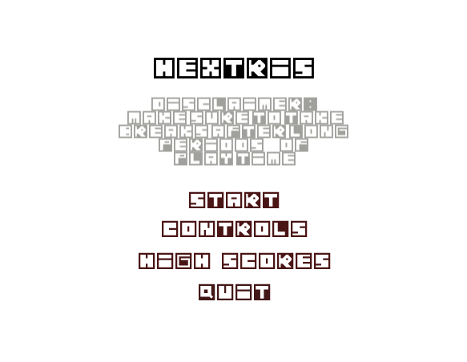
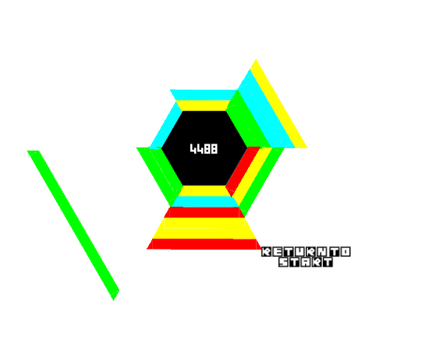
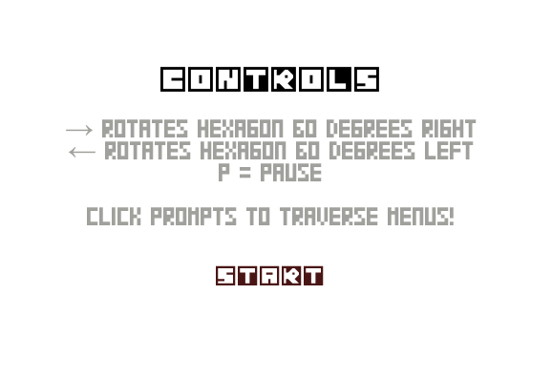
Features
Start Menu with access to all features and function
8 bit background music and elimination sound effects for immersive experience
Easily seen score counter
Easily accessible instructions

Slide 6
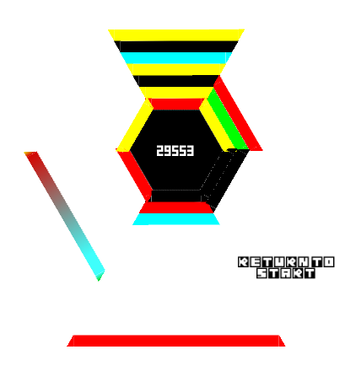
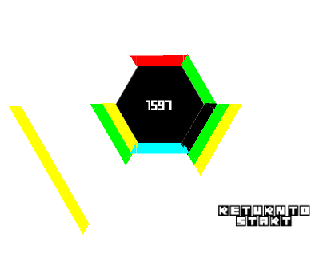
Features Continued
Black trapezoid that block the player and won’t match with any blocks
Rainbow trapezoid that will destroy any trapezoid that it touches including black one

Slide 7
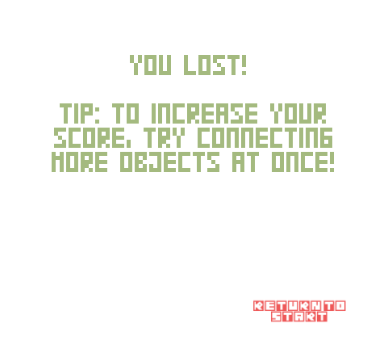
User Friendliness
Additional tips to help the players
Locally tracked top scores to record improvement
Easily accessible instructions

Slide 8
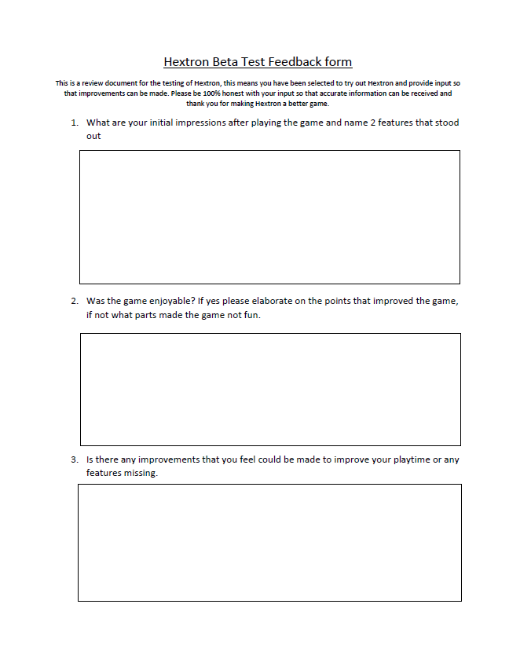
Feed back
Positive
Game is simple and easy to pickup
Music adds some whimsy and is cute
Game has easily accessible instructions and interface
Game controls are very simple using only left and right keys
There's tips that can answer some question
Nice resolution options
Constructive Criticism
There’s no explaining what the black and 2 colored blocks do
Your score isn’t tracked if you lose and is lost unless you made the top 5
Music can be annoying playing after a while, needs option to turn it off
Small visual glitches

Slide 9
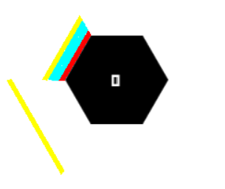
Robustness
Simple game needs to run very smoothly being able to run efficiently and effectively for any length of play
Focused on the handling of unusual playstyles and inputs
Wanted to cover situations that would create errors and crashes as well as covering standard scenarios

Slide 10
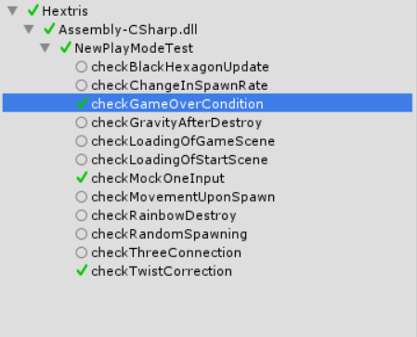
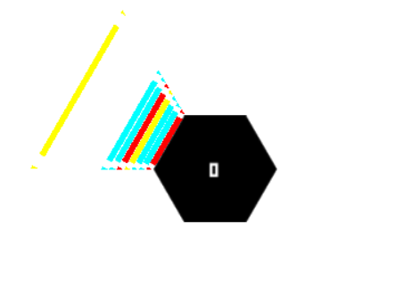
Testing
Dynamic Automated Testing (Runtime checking)
Test cases inputted for various cases and implemented through live runtime
Over 15 automated test cases
Twisting test case – covers the block twisting exception which occurred when rotating and causing the trapezoid to crash into the side of a stack
Rainbow destroy – covers the effect of the rainbow block on trapezoids creating red blocks and eliminating them with the rainbow block.

Slide 11
Thank You
Hextron
Thank You From: Scott Williams, Jason Li, Yousaf Shaheen

